Slide 1
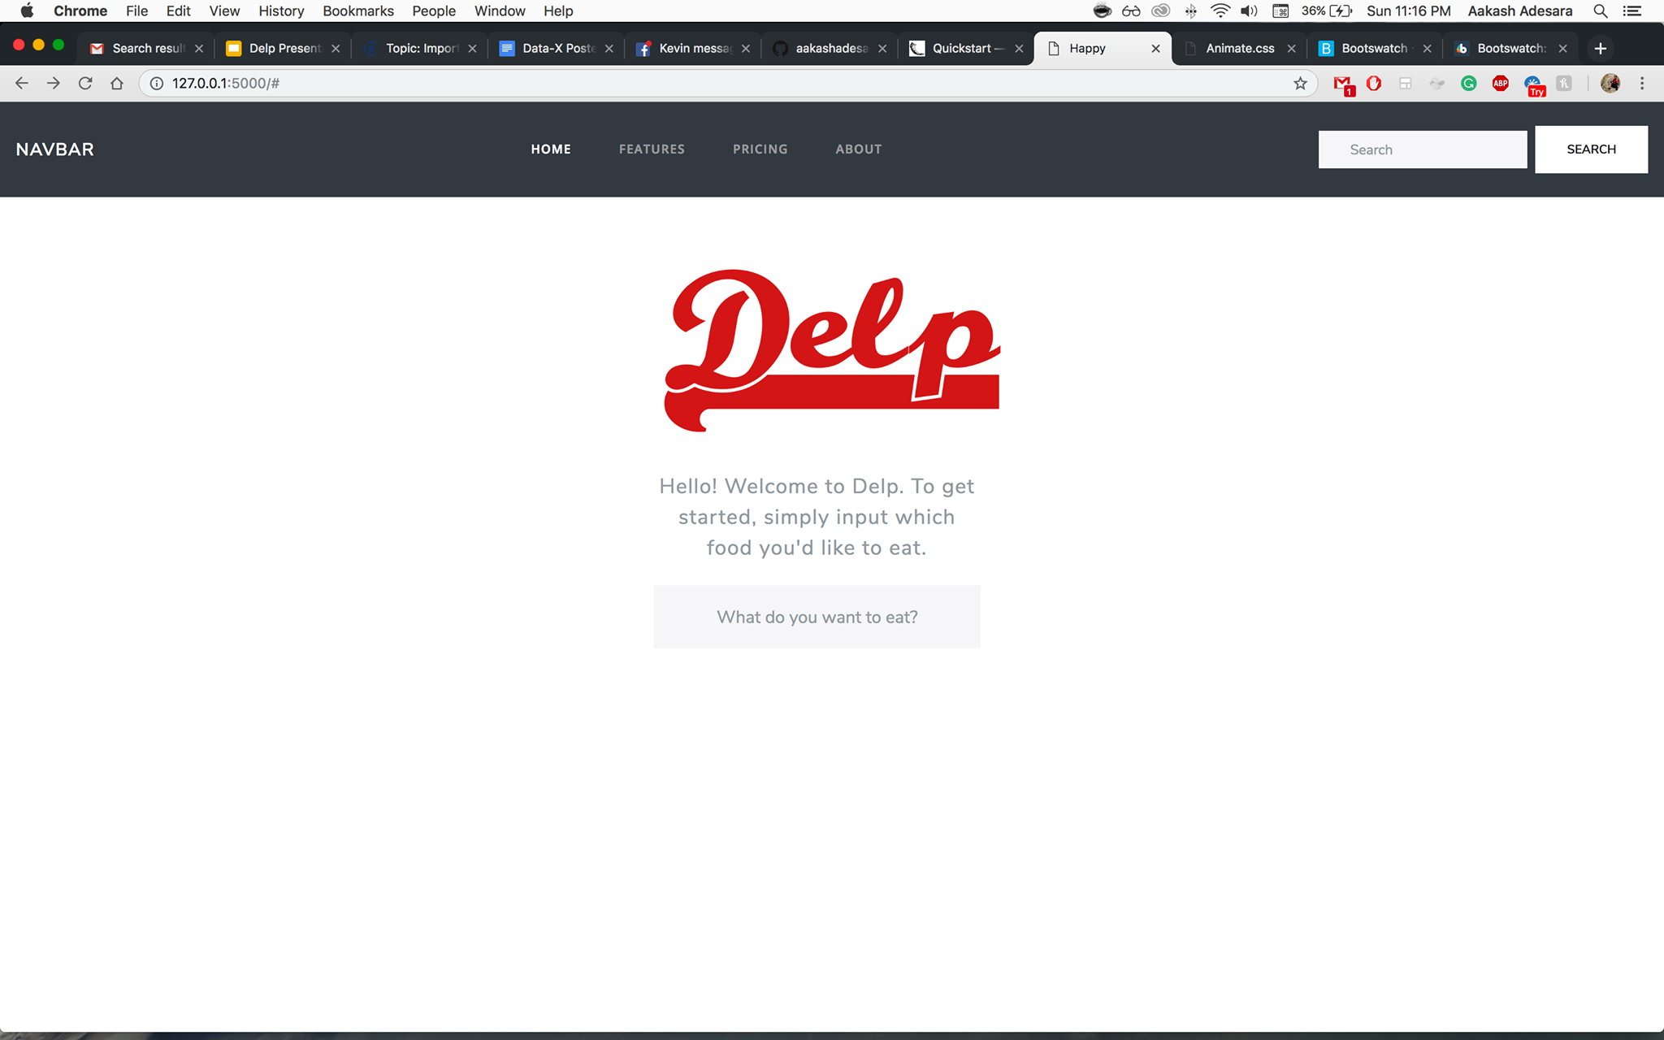

Delp
NLP powered Food Recommender to help you pick the best dish from the best restaurant using big data.
Aakash Adesara, Alan Liang, John Ly, Kevin Ko, Mihir Thummar

Slide 2

User Story (Case 1) The story of a SF traveler
Jaxon is at a new restaurant in San Francisco
He goes to Yelp and is forced to read many reviews to synthesize what is good and bad.
How inconvenient!
He wishes the Yelp would just recommend the best food at this restaurant.
While in line, he doesn’t know what to get: what’s good?

Slide 3
Introduction to Delp
Collects data on restaurants and yelp reviews to determine the best items to get using sentiment analysis
User can search for specific food items and get instant restaurant recommendations based on others’ reviews and ratings
Saves the user time so they can quickly decide what to try instead of having to manually read through all the reviews
Enjoy (hopefully) good food from popular opinions (BIG data)

Slide 4
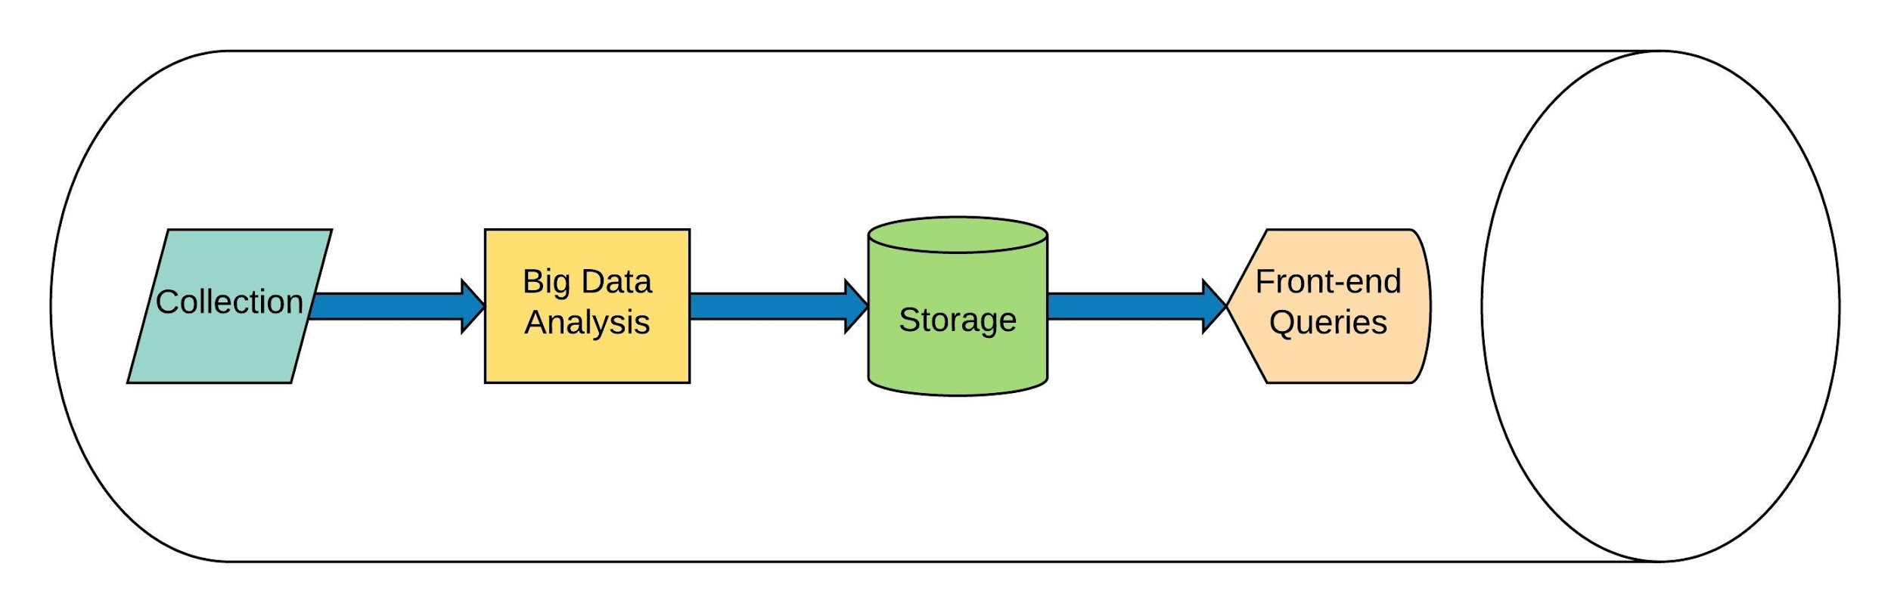
Architecture

Slide 5
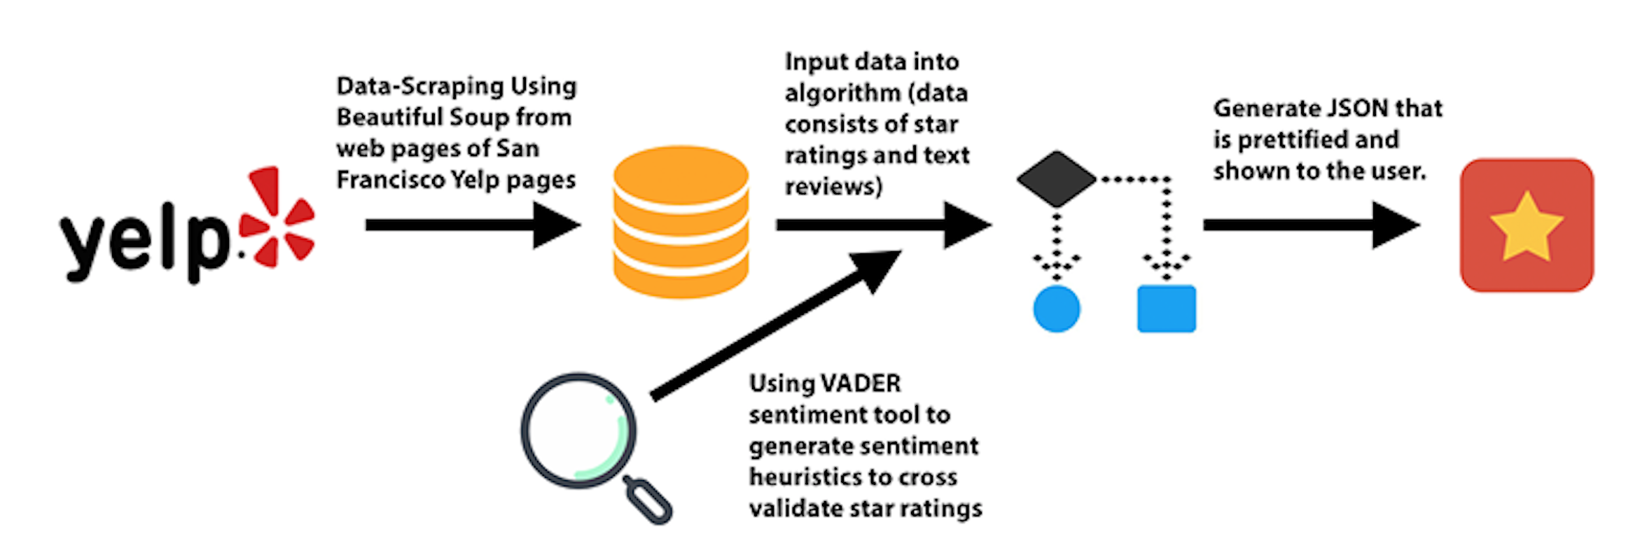
Holistic Overview of our Process

Slide 6
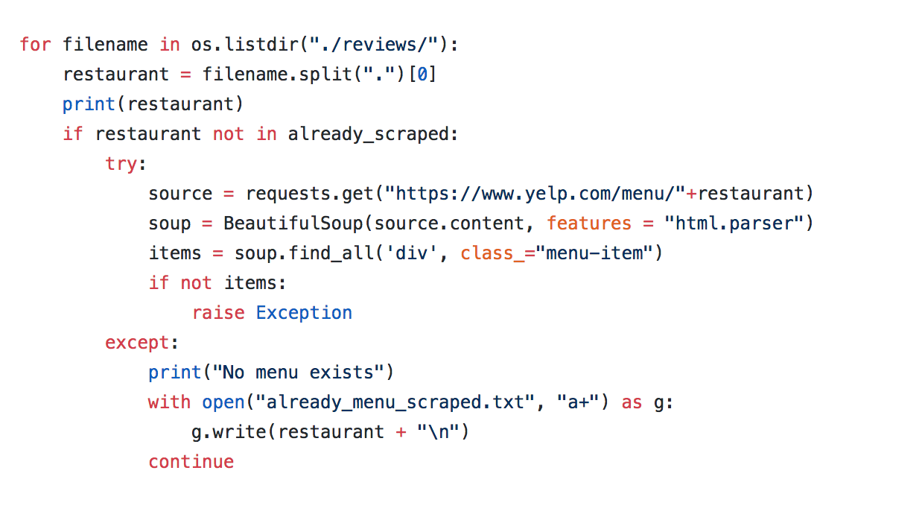
Backend
Used BeautifulSoup in order to scrape all the menu items for each restaurant that had an available menu. Below is a small snippet of our code:

Slide 7
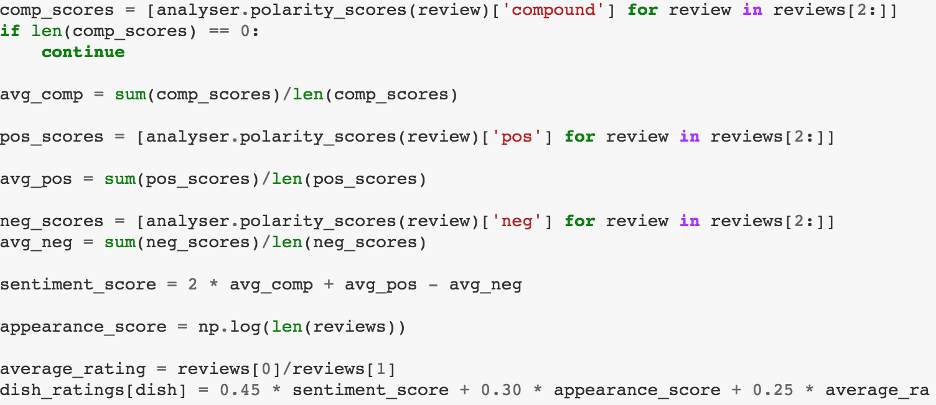
Backend Continued
For each restaurant, we grouped sentences by which dishes they referred to by detecting the dish names in the sentence and also considering sentences in the same vicinity
Then we scored the sentiment of the grouped sentences for each dish using Vader and then averaged the scores and normalized them using a homemade weighting algorithm. The final score for the dish incorporated the sentiment score, the number of times it was mentioned, and the stars that the reviews that contained the dish had. A snapshot of the algorithm is below:

Slide 8
Backend Continued
The results of all the top dishes ranked for each restaurant were stored in a JSON object and queried in the frontend
For our frontend, we used a python library called Flask in which we developed an elaborate frontend web application in which the user enters in his or her favorite dish and we return a list of restaurants that have that dish in their menu along with the percentile ranking of that dish within each restaurant
This way the user immediately has the top restaurants to go to for a particular dish

Slide 9
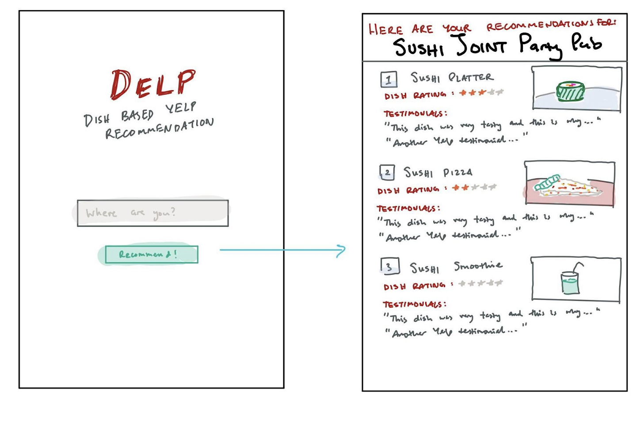
Intended UI
We wanted to keep our UI very simple.
User inputs their restaurant.
Presses “Recommend”.
Gets top restaurants for a dish based on sentiment analysis.
BUT…. we revamped our frontend entirely….

Slide 10
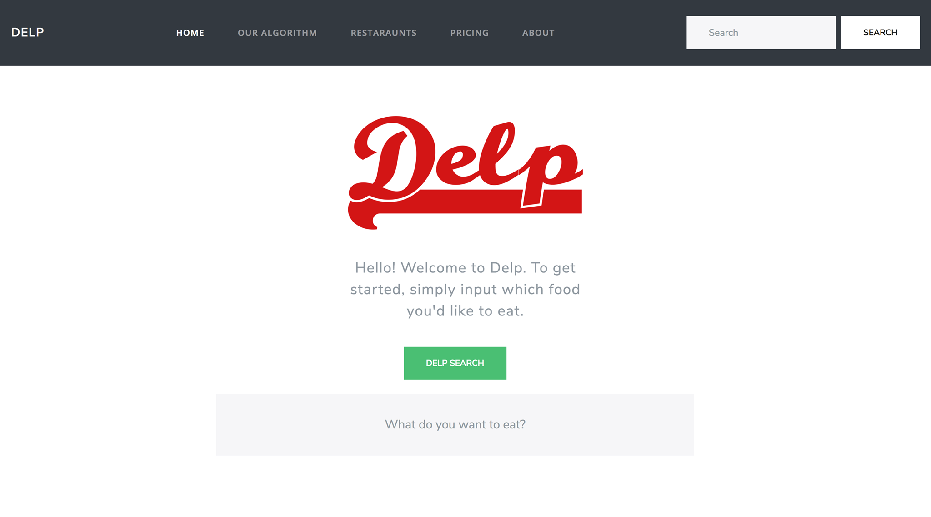
Actual UI

Slide 11
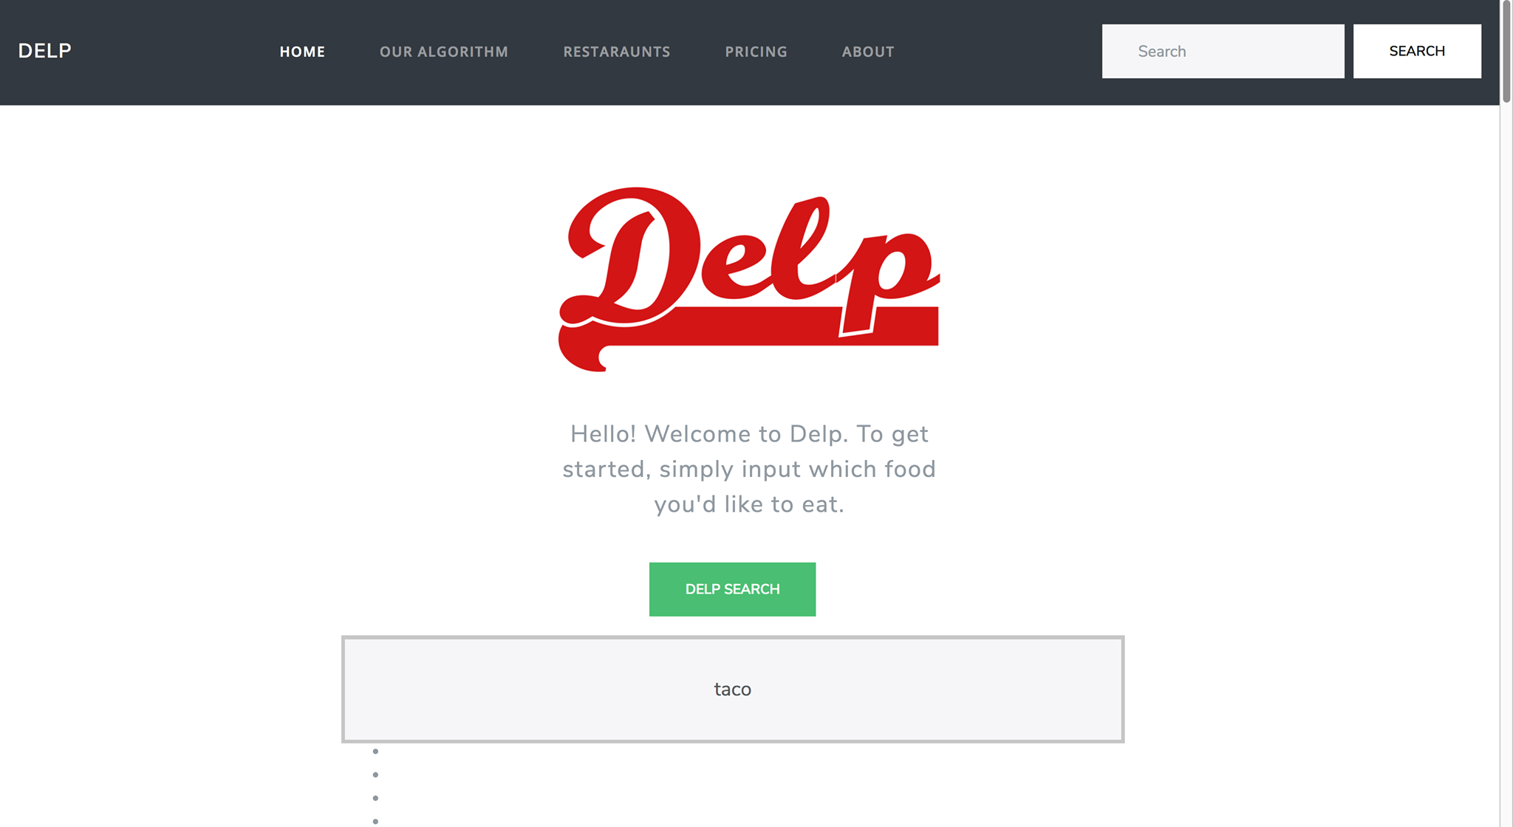

Slide 12
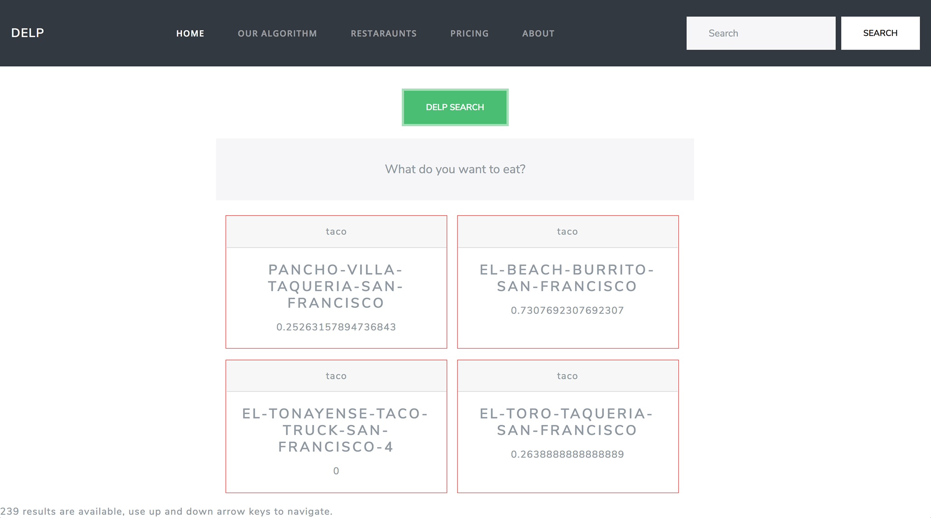

Slide 13
Learning Path
What recommendation should we give to the users?
It would be difficult to implement a search feature for restaurants
need to index restaurants and build text search
users don’t know what restaurants are available
Solution: recommend restaurants based on common food items
How to perform named entity recognition for each review to determine whether a review contains a food item?
This task is exponentially difficult because there are infinite number of food items and people have different spellings and it is very difficult to identify a noun as a “food” item in particular.
Solution: we scrape data from restaurants that have a menu on Yelp
Notes:
Search feature challenge: we would need to index restaurants, users don’t know what restaurants are available.

Slide 14
Live Demo!
We are going to show you Delp in action now.

Slide 15

Q&A

Slide 16
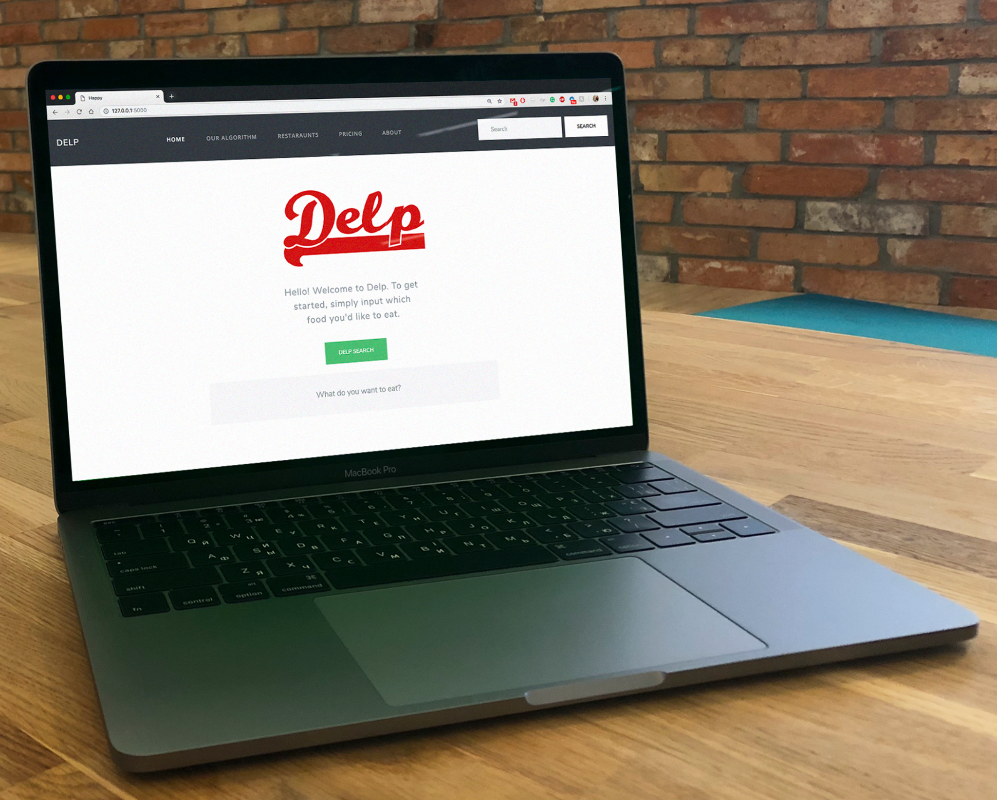
Try it yourself!
Github Repo:
https://github.com/johnly98/Delp

Slide 17
Final Comments
If we had more time with this project we would add features to our model incorporating location preferences, budget constraints, and party size
We would also use more computational power and better NLP algorithms in order to identify and rank dish sentiment not only in SF but all locations in the world

Slide 18
Thank You
Check out our project at: https://github.com/johnly98/Delp

